Slide 1

Digital Doctor Prescription System
Presentation by Mohamed Razeeth
April - 2025

Slide 2
Project Overview
GOAL
Meaningful healthcare insights via prescription data analysis.
Summary
This project focuses on cleaning raw prescription datasets, storing them in a structured MySQL database, and leveraging data analysis tools to uncover trends, patterns, and revenue opportunities within healthcare services

Slide 3

Data Cleaning Process
DATA MANAGEMENT STEPS
The initial uncleaned CSV file underwent a rigorous cleaning process. The cleaned data was stored in MySQL for easy retrieval, ensuring data integrity.
Retrive the stored data fro mysql and show the reasonable insights for business growth and analysis

Slide 4
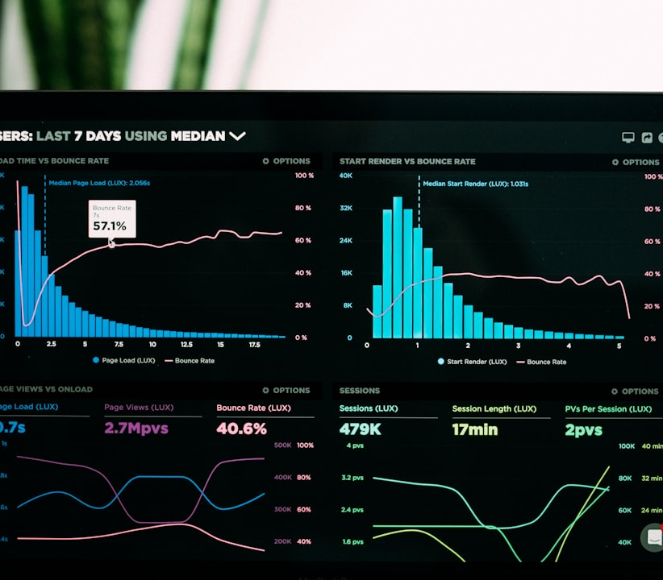
Key Insights Overview
Key Dataset Columns
patientid
doctorname
medicinename
dosage
price
frequency
date
diagnosis
notes
price
Tools
Python
Msql
Pandas
Numpy
Matplotlib

Slide 5
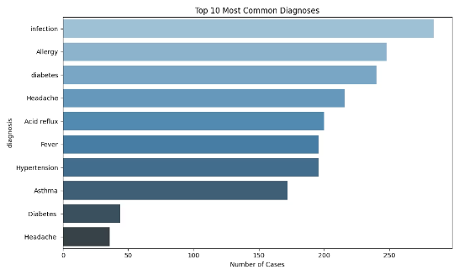
Most Common Diagnoses
This chart will show top 10 most common medicines
This table presents the top diagnoses and their respective frequencies based on recent data.

Slide 6
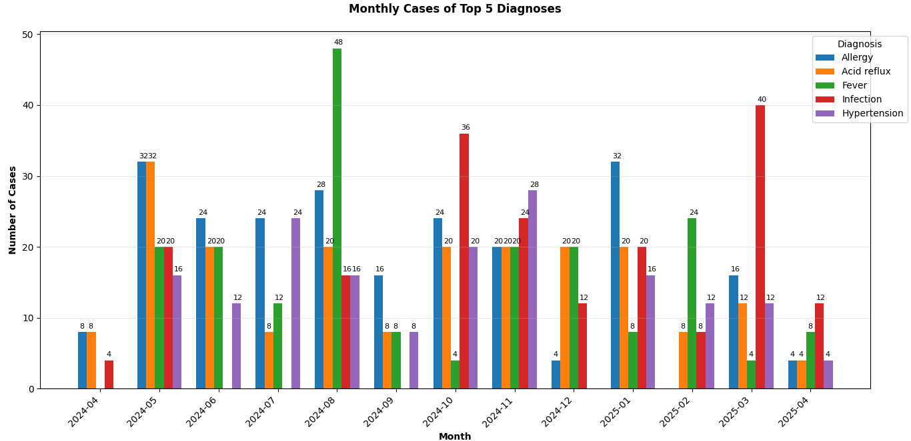
Monthly disease Trends
Disease trends based upon the month

Slide 7
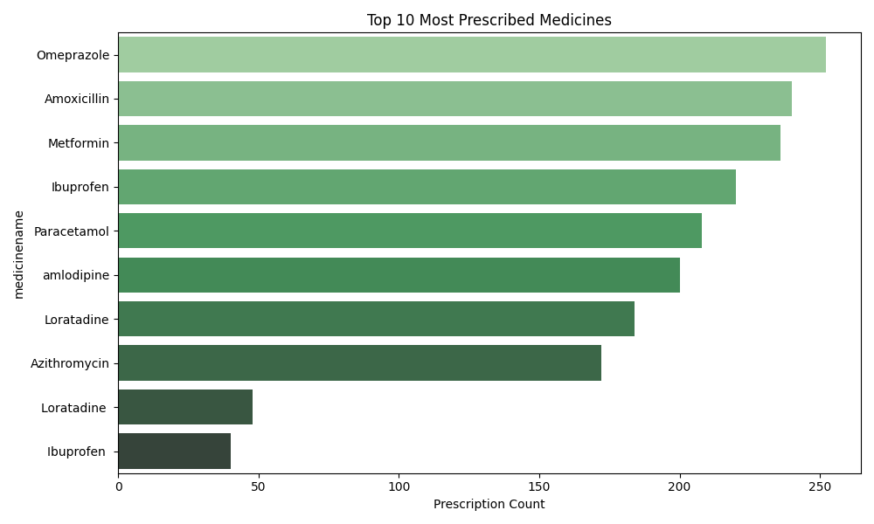
Most Prescribed Medicines
Top 10 most prescribed medicines

Slide 8
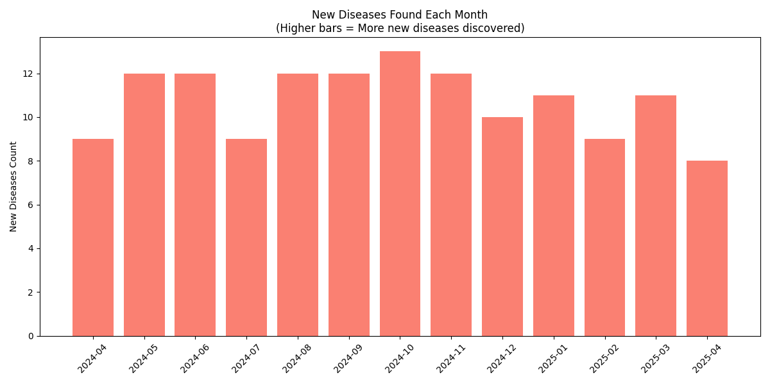
New emerging disease
New disease emerging based upon the month

Slide 9
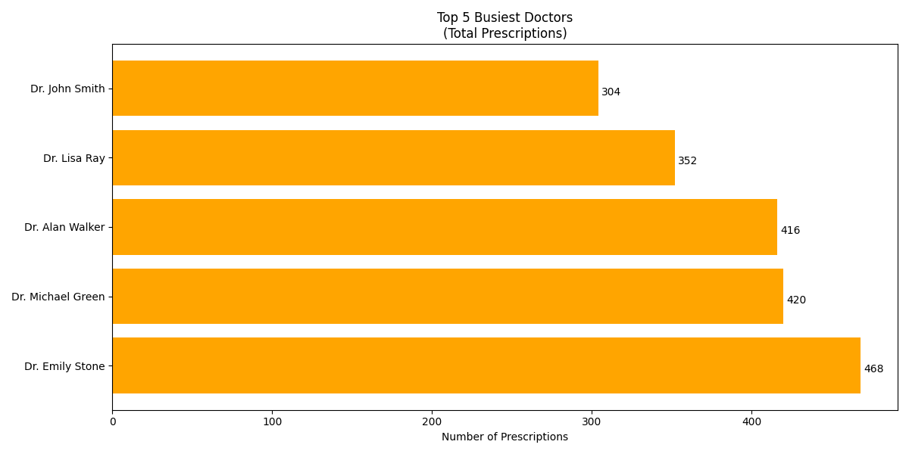
Doctor specific prescription
Top 5 busiest Doctors or most prescribed doctors

Slide 10
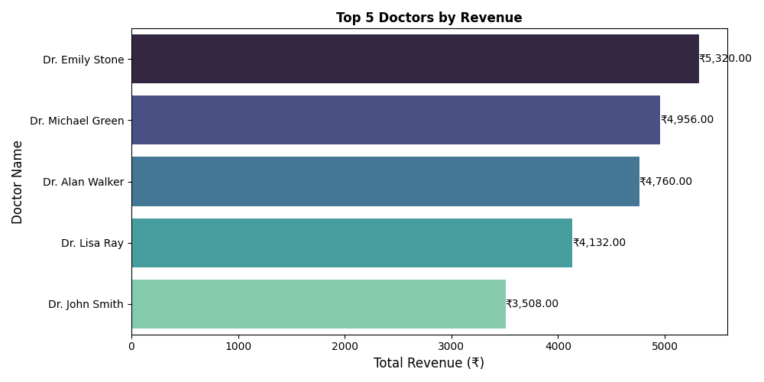
Doctor specific revenues
Revenues generated by each doctor

Slide 11
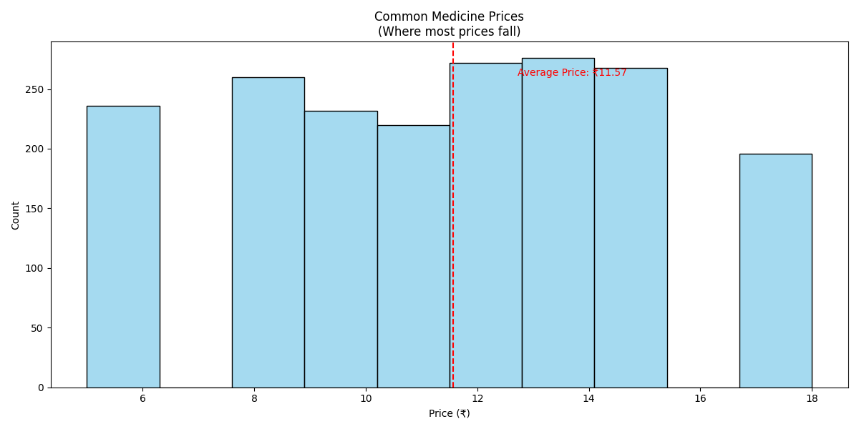
Medicine price distribution
This chart shows count of the medicines as per the price

Slide 12
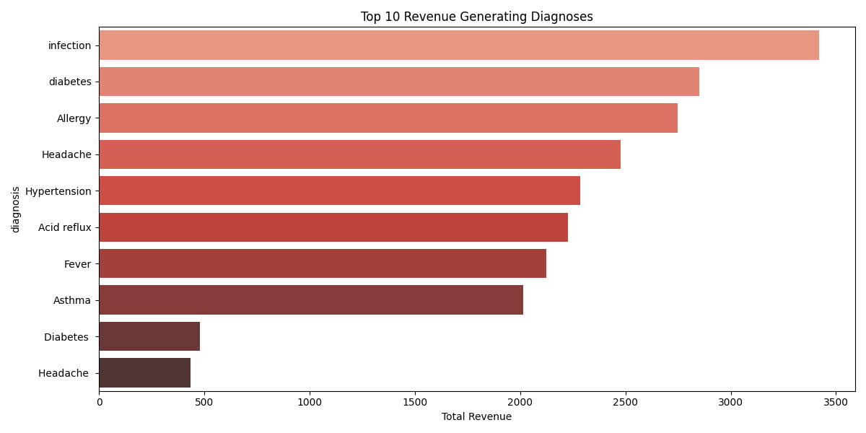
Revenues by diagnosis
This will shows the total revenues based upon the diagnosis

Slide 13
Github for source code:
Github/digital-doctor-prescription
Click the link get the source code

Slide 14
Conclusion & Recommendations
Smarter Decisions
Early Detection
Better healthcare decisions through data analysis
Early disease detection, optimized pricing.
Enhanced Care
Enhanced patient care and
outcomes
Thank you !

